Slide 1
Replica Management and Consistency Protocols
Lecture-27

Slide 2
Replica Management
Replication is an important property in a distributed system. In other words, multiple copies of the selected files are maintained, with each copy on a separate file server.
The reasons for replication are as follows:
1. To increase reliability by having independent backups of each file.
2. To allow file access to occur even if one file server is down.
3. To split the workloads over multiple servers.
The first two points are related to improve reliability and availability. The third is concerned with the performance.
A key issue relating to replication is transparency. Whether the users are fully aware of the replication process and can even control it? Or the system does everything without user intervention?
In the latter case, we say that the system is replication transparent.

Slide 3
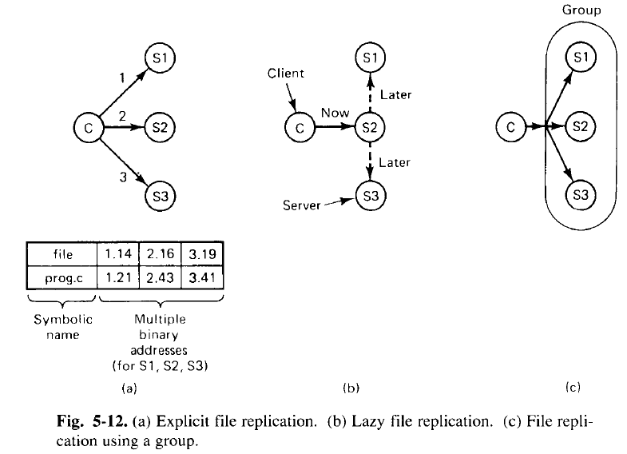
Cont..
Ways of performing replication:
1. Explicit file replication: The first way, shown in Fig. 5-12(a), is for the programmer to control the entire process.

Slide 4
Cont..
When a process creates a file, it does so on one specific server. Then it can make additional copies on other servers, if desired.
If the directory server permits multiple copies of a file, the network addresses of all the copies can then be associated with the file name, as shown at the bottom of Fig. 5-12(a), so that when the name is looked up, all copies will be found.
In Fig. 5-12(b), an alternative approach is used called as “Lazy replication”.
Here, only one copy of each file is created, on some server. Later, the server itself makes replicas on other servers automatically, without the programmer’s knowledge.
The system must be smart enough to be able to retrieve any of these copies if needed.
When making copies in the background like this, it is important to pay attention to the possibility that the file might change before the copies can be made.
Fig. 3-12(c) shows a way of replication known as “Group communication”.
In this scheme, all WRITE system calls are simultaneously transmitted to all the servers, so extra copies are made at the same time the original is made.

Slide 5
Cont..
There are two principal differences between lazy replication and using a group.
First, with lazy replication one server is addressed rather than a group.
Second, lazy replication happens in the background, when the server has some free time whereas when group communication is used, all copies are made at the same time.
Update Protocols: Used to modify the existing replicas.
Primary copy replication:
In this replication, one server is designated as the primary and all the others are secondaries.
When a replicated file is to be updated, the change is sent to the primary server, which makes the change locally and then sends commands to the secondaries, ordering them to change, too.
Reads can be done from any copy, primary or secondary.

Slide 6
Cont..
The disadvantage of this method is that if the primary is down, no updates can be performed.
To get around this asymmetry, Gifford (1979) proposed a more robust method, known as voting.
The basic idea is to require clients to request and acquire the permission of multiple servers before either reading or writing a replicated file.
As a simple example of how the algorithm works, suppose that a file is replicated on N servers.
We could make a rule stating that to update a file, a client must first contact at least half the server + 1 (a majority) and get them to agree to do the update.
Once they have agreed, the file is changed and a new version number is associated with the new file.
The version number is used to identify the version of the file and is the same for all the newly updated files.

Slide 7
Cont..
In the Gifford’s scheme, to read a file of which N replicas exist, a client needs to assemble a read quorum, an arbitrary collection of any N_{r} servers or more.
Similarly, to modify a file, a write quorum of at least N_{w} servers are required.
The values of Nr and Nw are subject to the constraint that Nr + Nw > N.
Only after the appropriate number of servers has agreed to participate can a file be read or written.
To see how this algorithm works, consider Fig. 5-13(a) which has N_{r} = 3 and N_{w} = 10.
Imagine that the most recent write quorum consisted of the 10 servers C through L.
All of these get the new version and the new version number.
Any subsequent read quorum of 3 servers will have to contain at least one member of this set.
When the client looks at the version numbers, it will know which is most recent and take that one.

Slide 8
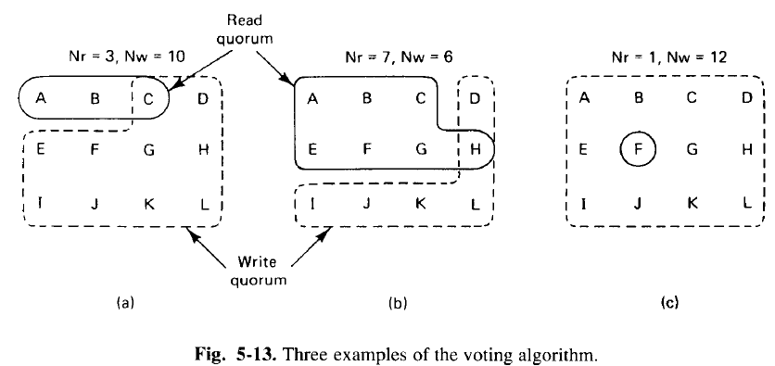
Cont..
In Fig. 5-13(c), N_{r} = 1, making it possible to read a replicated file by finding any copy and using it.
However, write updates need to acquire all copies.

